Slide 1
You are currently muted. To ask a question, or make a comment, please raise your hand.
When your hand is raised,
the button will look like this:
You may also send a message to
the facilitator through the questions window.

Slide 2
Agenda Residential Care: Supporting Physicians Leading Change
Intro to the webinar and review of technology - Dr. Bekker and Michelle Briere Tell us any further thoughts from our last webinar: Costs and benefits from changing patient/physician assignments Care Conferences - Tips for best implementation Tips to ensure care conferences appear accessible/attractive to GP’s Tips to ensure care conferences produce the most benefit to the patient and caregiver team Bob Mack (Penticton) Trevor Janz (Nelson) Steve Larigakis (White Rock) Jen Bitz (Central Okanagan) Jamie Ashton (Vancouver) Ian Bekker (Victoria) 4. Care system change evaluation results Jamie Ashton (Vancouver- RCI) Ian Bekker (Victoria -TORCH)

Slide 3
Care Conferences

Slide 4
Care Conferences
A meeting to discuss how to best care for the resident.
Invited:
Staff who work with the resident (RN, PT, OT, Diet, Rec, S/W)
Family
Resident
Pharmacist
Physician
Occur on admission and annually (some do every 6 months)
Everyone gets a chance to ‘give report’. Take about 30 mins
Physicians often don’t see the benefit exceeding the cost of attending.

Slide 5
Care Conferences – Problem?
Attendance to care conference is one of the best practices for RCI funding because it really really improves patient care.
Physicians make better decisions when they know the “big picture”. Everyone needs to paddle the same direction
Physicians see this as a reason not to join RCI. “I just can’t go to care conferences”.
Why?

Slide 6
Care Conferences - Solutions
Goal: Think of ways to bring physicians to care conferences
Tips to ensure care conferences are accessible/attractive to GP’s - i.e. scheduling, belief in their value and efficiency.
Tips to ensure care conferences produce the most benefit to the patient and caregiver team

Slide 7
Care Conferences
Dr. Bob Mack

Slide 8
The Penticton Care Conference Development Process
Existing situation- physicians rarely attended because not given sufficient notice of schedule. Meetings felt not to be a good use of their time
Created a Package of tools for time-efficient care conference –things to do 1 month prior, 1 week prior, day of conference. Instructions for facilitator, presenters, physicians. Physician MOAs were notified 1 month prior and a mutually agreed date was set.
Tips:
Each presenter emphasizes change.
MRP summarizing and distilling the input, suggest what the future held.
Medications and End-of-life.
If family requires more lengthy discussion, we encourage them to make an appointment to see the MRP later in the office.
Many physicians skirted around discussing end-of-life issues. Our better facilitators would prompt them.
What we learned--this approach doesn't work well in isolation. We had to do some team building first.
A large benefit of care conference attendance is that it increase the MRPs' presence in the facility. We encouraged pro-active facility visits by the MRP ...and they responded. This was very well received by facility staff

Slide 9
The Penticton Care Conference Development Process
Facilitator is the key person in the meeting. Not necessarily the nurse administrator---some of whom were uncomfortable in the role. The facilitator would receive formal training from our Education division before running a meeting.
We are told that it takes 2-3 years to change the culture of a facility…and we saw this. We had facilities providing excellent Care Conferences yet with the loss of a key person there was rapid loss of the structure. We believe that there will need to be a quality control person on the ground…which is a role for our new position of Physician Champion

Slide 10
Care Conferences
Dr. Trevor Janz

Slide 11
Save Time and Improve Care
Save time - one thirty minute care conference is worth more than ten calls or 23 faxes
Communicate once - all the players are in the room at once; family, nurses, care aids, pharmacist
Improve communication and build rapport with family and team – will save time eventually
Look good when there are tough questions- all the answers are in the room. Let staff answer the hard questions.
Medication review easily done – during or right after the care conference
Improve the quality of people’s lives - Family and resident are much happier

Slide 12
Getting the Most Value
Have a set agenda and stick to it. Outline timing at the beginning, and don’t get stuck.
Delegate sidebar conversations about the food, the laundry, or the lost blue sweater to the appropriate person, and move on.
Agenda
Introductions
Family concerns on the table
Medical problem list/ med review
Personal care
Key question; What has Changed?
Feeding
Activities and quality of life
Advance Care Planning (Bill 18220 with start/end times >20 minutes)

Slide 13
Getting the Most Value
Good questions for late dementia:
How much of the day is John sleeping?
Can John communicate his needs?
Do you think John is having any pain?

Slide 14
Care Conferences
Jen Bitz

Slide 15
Tips to ensure care conferences are accessible/attractive to GP’s
Have one person responsible for scheduling
Request preferred times from physicians and keep on file for scheduling purposes
Schedule the physician 4-8 weeks in advance
No more than 3 care conferences in a row
Be flexible
Scheduling options:
Option A – GP in attendance with the family, MRP, RCC, allied health workers
Option B – GP virtual attendance via video or telephone
Option C – Preconference with allied health workers and RCC. Subsequent reports carried forward to a smaller meeting with the MRP and RCC. The family could attend either or both
Plan the care conference so the physicians piece is done in first 30 minutes
Invite the GP to leave if they need to once GP related issues have been covered off

Slide 16
Tips to ensure care conferences produce the most benefit to the patient and caregiver team
Ask patient and members of the caregiver team for concerns to discuss in advance
At the outset be clear and transparent about what is to be accomplished during the conference
Have all the necessary paperwork organized in advance

Slide 17
Care Conferences
Dr. Steve Laragakis

Slide 18
Principles
A good conference will be appealing for the doctors to attend and a valuable learning and team building exercise for all the members. It will also reduce family fears, build trust, and lead to better patient care.
For Doctors :
Set a regular time for your meetings
Cluster patients for one doctor.
Link it to patient visits.
Make expectations clear at beginning of conference. Medical issues only. Not laundry
For the Team:
Have everybody from the team there. And the chart.

Slide 19
Principles
If family can't come, have them phone in.
Start with brief description of person, eg kindergarten teacher, not cva/dm/ckd/gerd
Each team member presents precise description of their part
Pharmacist list drugs with indication, and view to polypharmacy reduction
By the time it gets to the doctor only thing left is review goals of care, expected trajectory, and MOST
Set a regular time for your meetings, preferably a non office time, or book off a slot once every 2-4 weeks depending on the the number of residents you have. Have the facility cluster all the patients for one doctor in one block to optimize efficiency and financial return. Also see the patient so you can bill for that.

Slide 20
Care Conferences
Ian Bekker

Slide 21
TORCH
We kept telling the facilities to organize care conferences for 6 months…. multiple meetings.
Each doctors said what 3 hour window per week they would make available and how much lead time they needed to schedule it. Turned out we picked Tues or Wed
Finally, clerk from my facility sat down and lined up all 22 of our patients in the year on our schedule.
Two pateints per session. Two sesions per week
30 mins each.

Slide 23
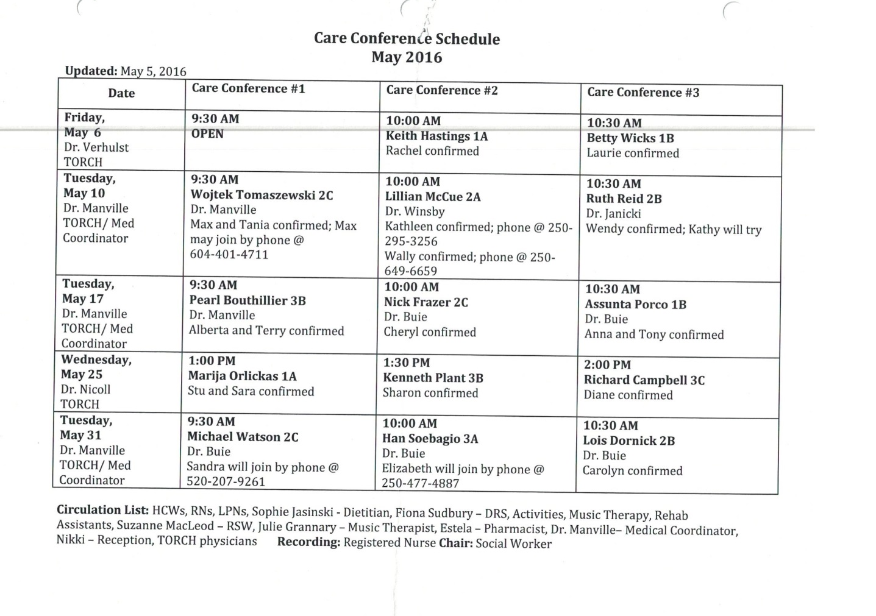
Another TORCH facility
Similar slow progress
Then arranged three patients per session

Slide 25
TORCH Practice Model Evaluation

Slide 26
TORCH
TORCH Prototype 2015
4 Facility teams, admin & clinical
19 Doctors
356 Residents

Slide 27
1. Effect on ER Visits and Transfers to Hospital

Slide 28
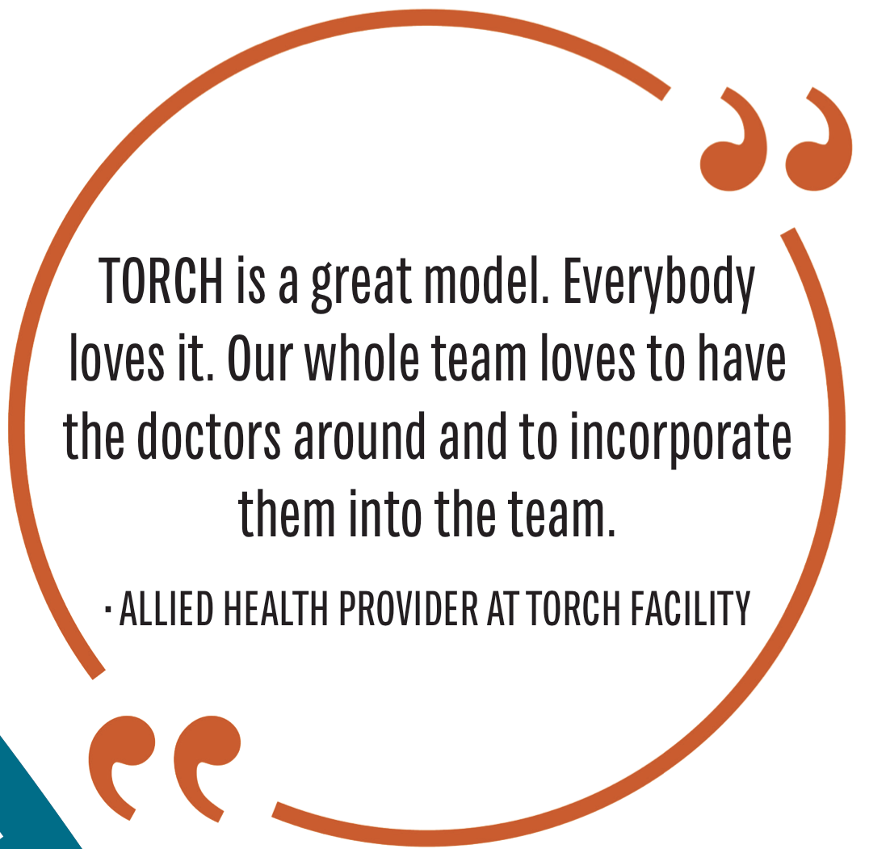
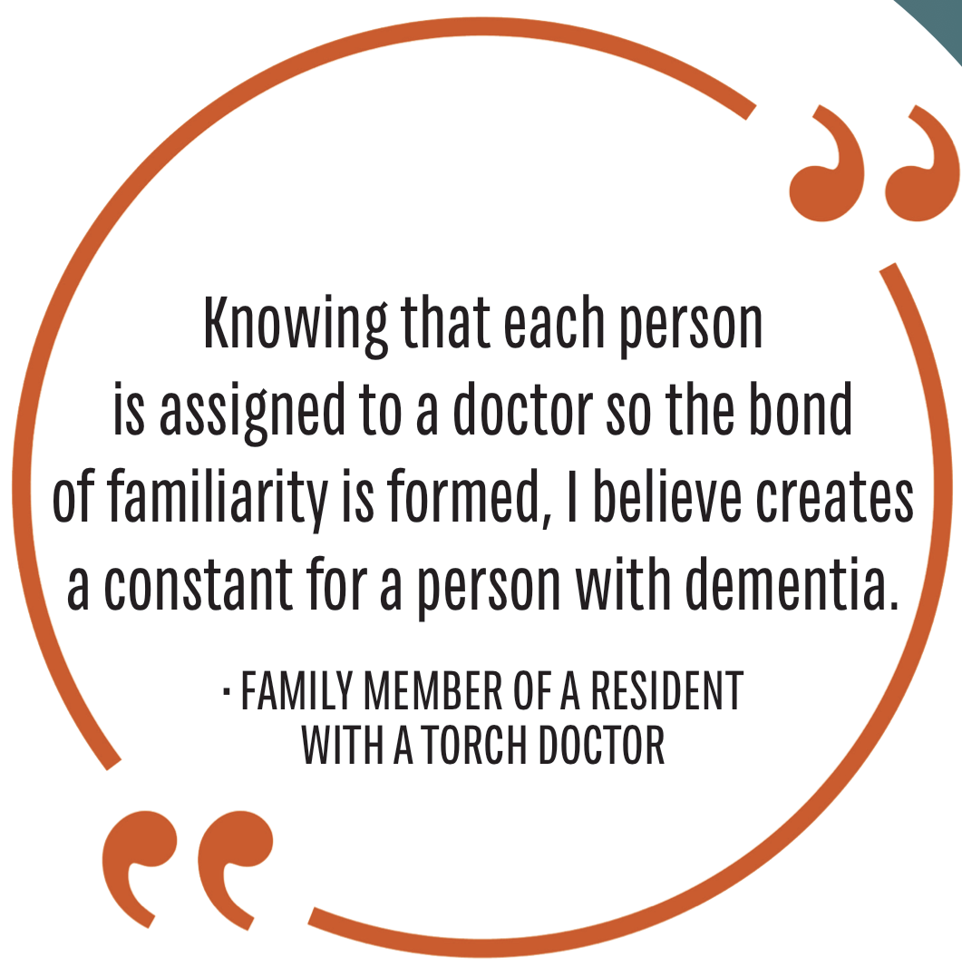
Patients are getting more comprehensive care. They don’t have to wait and we don’t have to try and diagnose over fax anymore.
- Nurse

Slide 29
2. Improved collaborative and team-based care

Slide 30
3. High quality of care provided by GPs
Notes:
Provincial Standard
Evidence
24/7 availability and on-site attendance when required
Call schedules were organized for each facility to enable 24/7 coverage
Most days of the week a TORCH physician was onsite
Proactive visits to residents (i.e. regular visits to residents)
Percentage of patients with at least one visit from a GP in 90 days increased from 37% to 97%
Percentage of first GP visit within 7 days of admission increased from 45% to 85%
Average number of days from admission to first GP visit decreased from 25 to 5 days
Meaningful medication review
Anecdotal evidence indicates that GPs are more involved in reviews
Completed documentation
Completion of Advance Care Plans (signed by a physician) increased from 53% to 90% of patients
Attendance at care conferences
Significant adaptation is occurring within care facilities to improve ability for GPs to attend conferences: A modest increase (6%) more GPs were able to attend care conferences since TORCH was implemented

Slide 31
4. High patient and provider satisfaction
Notes:
Physicians: part of care team,
Facility: streamlining admissions
Patients/ caregivers: ability to access care, physician part of care team

Slide 32
[There is] a reduction in stress, knowing you have the burden of care for a resident and a physician will be coming in. Now we know things will be taken care of a lot sooner.
– Facility-based Care Provider

Slide 33
4. High patient and provider satisfaction
Notes:
Physicians: part of care team,
Facility: streamlining admissions
Patients/ caregivers: ability to access care, physician part of care team

